Slide 1
Nondestructive Examination (NDE)
College of Engineering
Nuclear Engineering Department
The University of Tennessee

Slide 2
Introduction to NDE
Nondestructive Examination (NDE) uses the measurements of important characteristics of a structural or machine component to determine its physical soundness without altering or impairing its continued service (according to EPRI).
NDE/NDT leaves the components undamaged (large and expensive components)
NDE is an engineering tool to assure quality, reliability, and productivity.

Slide 3
Introduction to NDE
Proper implementation of NDE technologies minimizes field repair and liability losses
Detecting, locating, and sizing
Because of different merits and limitations of NDE methods, full inspection of a material or component usually requires more than one NDE method
Applications: detecting flaws and displacement, physical, structural and dimensional assessment,
Maintenance and condition monitoring techniques:
Non-destructive testing
Destructive testing (mainly based on fracture mechanics)

Slide 4
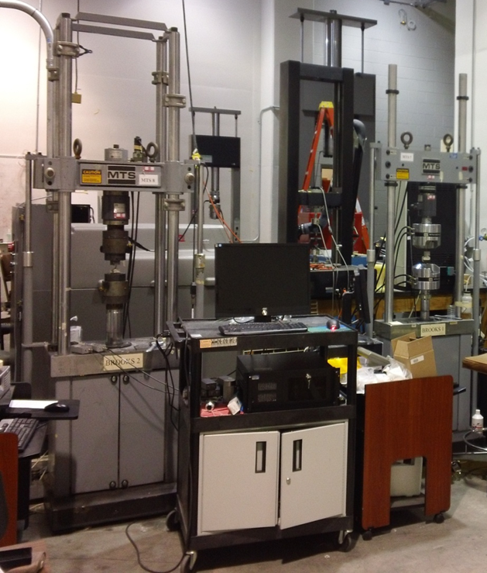
Destructive Examination (e.g. Material testing and crash test)

Slide 5
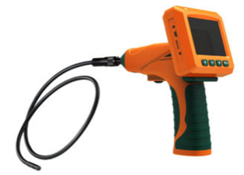

Some Common NDE Technologies
Visual Examination (vision systems?)
This should always be the first method applied.
Advanced techniques: Microscopy, Laser holography
Applications include surface discontinuities: cracks, deposits, misalignment, incorrect size, oxidation, welding problems , corrosion.
Advantages: Inexpensive, fast, simple, can eliminate need for other methods.
Limitations: Surface only, poor resolution, eye fatigue, needs good illumination.

Slide 6
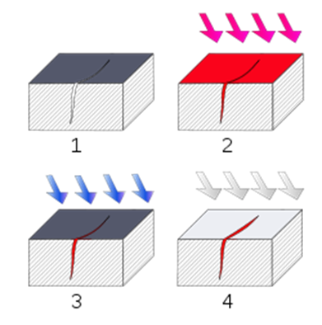
Some Common NDE Technologies
Dye Penetrant Examination
To locate surface-breaking defects in all non-porous materials - metals, plastics, or ceramics
Visible/fluorescent penetrants (shiny)
Procedure:
Section of material with a surface-breaking crack that is not visible to the naked eye.
Penetrant is applied to the surface.
Excess penetrant is removed.
Developer is applied to provide visual contrast, rendering the crack visible.

Slide 7
Dye Penetrant Examination
Applications include surface discontinuities: cracks, porosity, leaks, etc.
Advantages: Inexpensive, easy to apply, more sensitive than visual alone, rapid, portable, and can be used on most materials..
Limitations: Surface only, not useful on hot, dirty, and painted surfaces; requires trained personnel.
Remarks: Messy, needs good ventilation.

Slide 8
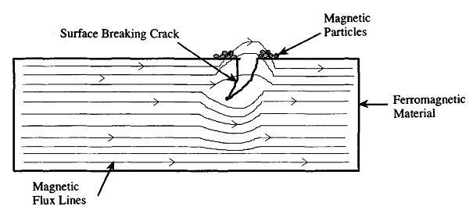
Some Common NDE Technologies
Magnetic Particle Examination
Inspection of ferromagnetic materials
Detect: surface breaking cracks
X.E. Gros, NDT Data Fusion, John Wiley & Sons, Inc., London, 1997

Slide 9
Some Common NDE Technologies
Eddy Current Testing (ECT)
Ultrasonic Testing (UT)
Acoustic Emission (AE)
Infrared Thermography
Radiographic Examination
Microwave Inspection
Leak Detection
Shearography
Acoustic Impact

Slide 10
Discontinuities and Defects
Discontinuities in a manufactured part are interruptions in the structure of the material and may lead to potential future problems.
Inherent discontinuities are introduced during the manufacture of raw materials. Examples: Voids and inclusions trapped in an ingot of steel.
Processing discontinuities are introduced during manufacturing. Examples: cracks formed in forging, laminations formed in rolling, cracks in machining or welding.

Slide 11
Discontinuities and Defects
Service Discontinuities: are introduced during the use of the part. Examples: corrosion, erosion, fatigue cracking in pipes, girders, vessels, etc.
Quality control through NDE must monitor the above situations during all three phases.
Defects are discontinuities that interfere with the usefulness of the part. Engineering judgment, expressed as codes or specifications, is used to determine if a discontinuity is a defect or not.

Slide 12
Considerations in the Selection of NDE Methods
Safety: how reliable the part or system must be.
Economy: what the incentives based on cost versus reliability improvement are.
Inspection constraints: what type of inspection can physically be made.
Advantages and disadvantages: which method will work most effectively for a given material and location.

Slide 13
Applications of NDE
NDE technologies are being applied extensively in the aerospace, power and process industries, and in monitoring civil structures.
Another important application of NDE is in medical diagnostics where X-rays, Computer-Assisted Tomography (CAT), Magnetic Resonance Imaging (MRI), Positron Emission Tomography (PET), and ultrasonic testing, are used routinely.

Slide 14
Examples of Engineering Applications of NDE
Pressure vessels, piping, and other stationary equipment.
Boiler and steam generator tubing.
Turbine blades, pump casing, bolting, etc.
All forms of weld joints.
Aerospace structures: wings, fuselage, engine supports, landing gear, etc.

Slide 15
In-Service Inspection (ISI) and ASME Codes
Continued in-service inspection (ISI) is necessary for equipment exposed to high pressure, temperature, and radiation conditions.
These requirements are published in the ASME (American Society of Mechanical Engineers) Boiler and Pressure Vessel Code.
Section XI of the Code deals with In-service Inspection of Nuclear Reactor Coolant Systems.

Slide 16
Summary of NDE Techniques Eddy Current Testing
Applications include surface and near surface discontinuities: cracks, composition, thickness, surface condition, eccentricity, etc.
Advantages: Extremely rapid, can be automated, very sensitive, surface contact not necessary, permanent record of testing is available.
Limitations: Shallow penetration, material must be electrically conductive, sensitive to geometry, difficult to interpret test data sometimes. Requires good standards.

Slide 17
Summary of NDE Techniques Ultrasonic Testing
Applications include surface and deep subsurface discontinuities: cracks, laminations, porosity, lack of fusion, inclusions, thickness, etc.
Advantages: Rapid when automated, applicable to very thick specimens, can give location and size of discontinuity, good sensitivity, inspect from one side, portable. This is a frequently used method.
Limitations: Couplant (usually liquid) required, thin complex shapes are difficult, depends on orientation of discontinuity. Requires good standards.

Slide 18
Summary of NDE Techniques Thermography
Applications: Voids or lack of bond or continuity, thin or thick sections, loss of insulation, detection of heat sources.
Advantages: Detect or locate hot or cold spots and heat generating discontinuities, permanent record, remote sensing, portable.
Limitations: Resolution, slow, specialized equipment are expensive, needs reference standards.

Slide 19
Summary of NDE Techniques Radiographic Testing
Absorption of penetrating radiation
Applications include subsurface discontinuities: cracks, voids, lack of fusion, inclusions, thickness variation, missing components, composition, etc.
Advantages: Easily understood, permanent records, usually moderate cost, applicable to a wide range of materials.
Limitations: Radiation hazard, cannot detect laminations, requires complex array of sensors.
Remark: One of the frequently used methods for high accuracy inspection (fuel inspection).

Slide 20
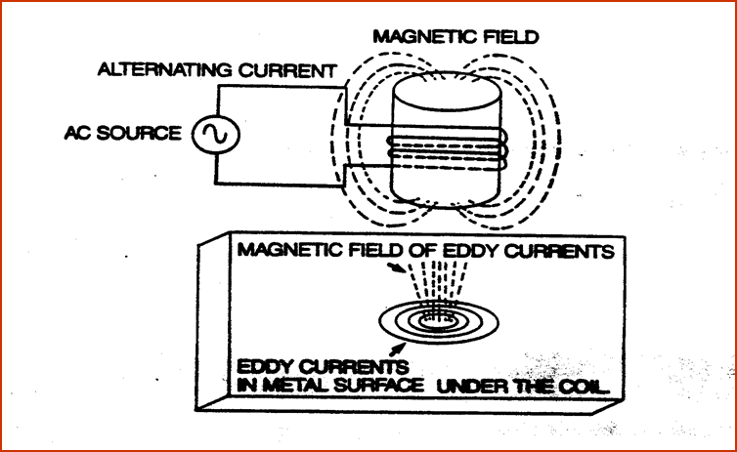
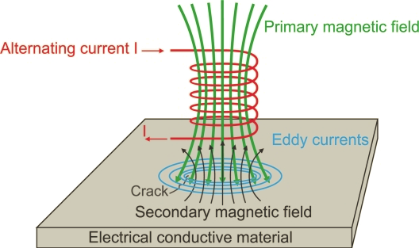
Eddy Current Testing (ECT)
ECT is a method of detecting and isolating surface or near surface flaws, as well as corrosion mapping.
ECT is used on electrically conductive materials.
It is based on inducing small, circular currents in a test specimen.
ECT uses high frequency AC current in a primary coil to generate a magnetic field which in turn induces circular eddy currents in the material of interest.

Slide 21
Eddy Current Testing (ECT)
The ECT device obtains a signal by disruption of the eddy current due to a flaw, causing a change in the opposing magnetic field, and thus changing the coil impedance.
ECT data consist of impedance plane signatures - inductive reactance and resistance.
R = Resistance, L = Inductive Reactance
Impedance magnitude = sqrt(R² + L²)
Impedance plane angle: tan(θ) = L/R

Slide 22
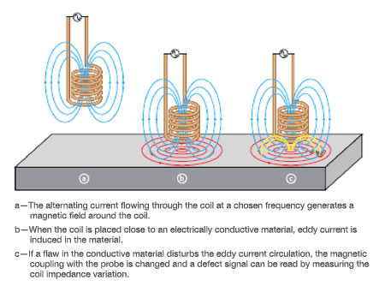
Eddy Current Testing (ECT)
www.olympus-ims.com/en/eddycurrenttesting

Slide 23
Eddy Current Testing (ECT)
Eddy currents are affected by changes in the conductivity and magnetic property of material.
Applications include detection and quantification of
Grain size, surface treatment, coating thickness
Hardness, composition
Cracks, inclusions, dents, holes, corrosion
Dimensions and geometry.

Slide 24
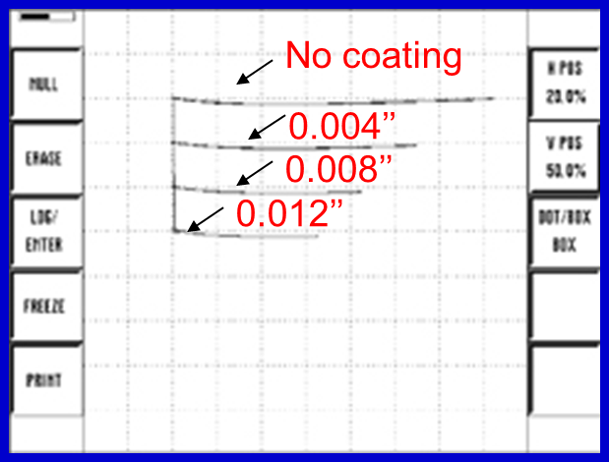
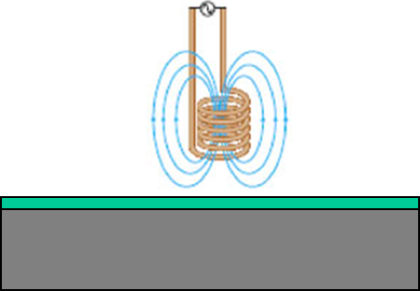
Eddy Current Testing (ECT) Measuring Coating Thickness
www.olympus-ims.com/en/eddycurrenttesting

Slide 25
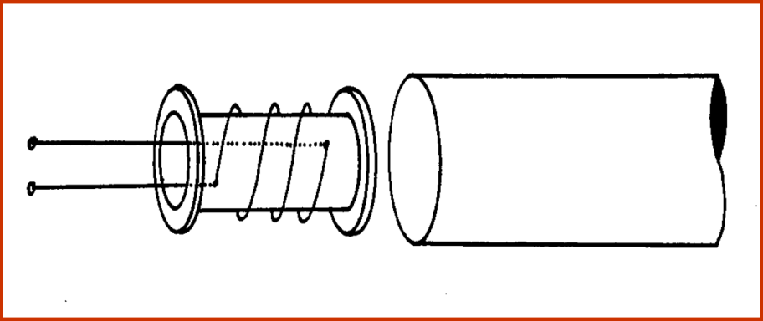
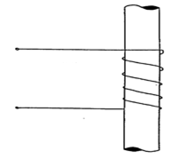
Examples of ECT Probes
Pancake or Flat Probe
For surface Examination
Bobbin Probe
For pipes and tubes inspection
Encircling Probe
Inspection of bar and tubular materials

Slide 26
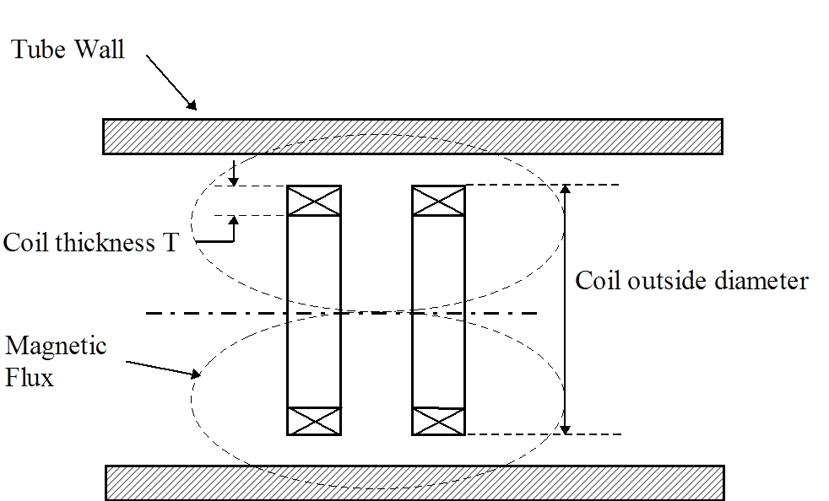
A Differential Bobbin Probe (complex signal – can detect sudden flaws)

Slide 27
Eddy Current Testing (ECT) Considerations
Examinations of heat exchanger, boiler, condenser, and steam generator tubing are the most common applications in the utility industry.
When an alternating current (AC) passes through a coil placed adjacent to an electrically conductive material, electrical currents (eddy currents) are induced in the material.
The coil is excited by applying a low-amp AC of 50 kHz – 1000 kHz.
The penetration of induced eddy current is inversely proportional to the AC frequency.

Slide 28
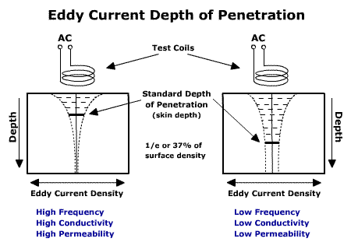
Depth of Penetration
http://www.ndt-ed.org

Slide 29
Eddy Current Testing (ECT) Considerations
The eddy currents, in turn, generate electromagnetic fields that oppose the primary coil field and thereby change its effective electrical impedance. The magnitude and phase of this parameter depend on
Probe-to-material distance
Geometry of the test piece
Material conductivity
Presence of defects
Thus, conditions that affect the material characteristics or defects present in the near-surface region can be detected by a change in the coil impedance.

Slide 30






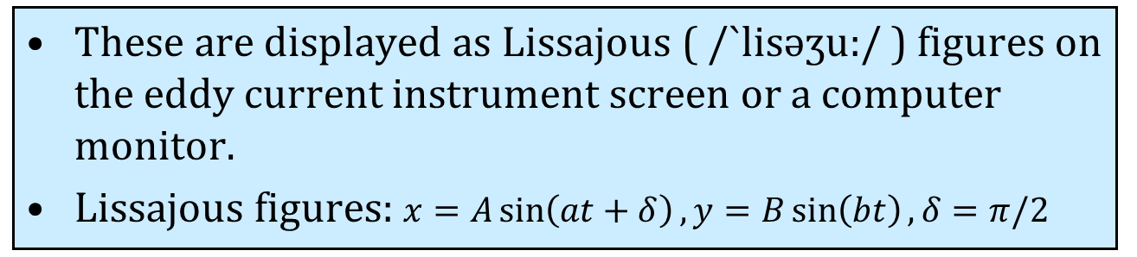
Eddy Current Testing (ECT) Considerations
These are displayed as Lissajous ( /`lisəʒu:/ ) figures on the eddy current instrument screen or a computer monitor.
Lissajous figures: $x=A\sin\left(at+δ\right), y=B\sin\left(bt\right),δ=π/2$
a = 1, b = 2 (1:2)
a = 3, b = 2 (3:2)
a = 3, b = 4 (3:4)
a = 5, b = 4 (5:4)
a = 5, b = 6 (5:6)
a = 9, b = 8 (9:8)

Slide 31
Flaw Characterization
Eddy current flaw characterization is performed using both signal amplitude and phase angle.
Signal amplitude is directly proportional to the flaw volume.
Phase angle is primarily affected by flaw depth.
Standard ASME tubing with known flaws is used for calibrating both phase angle and magnitude parameters in ECT equipment.

Slide 32
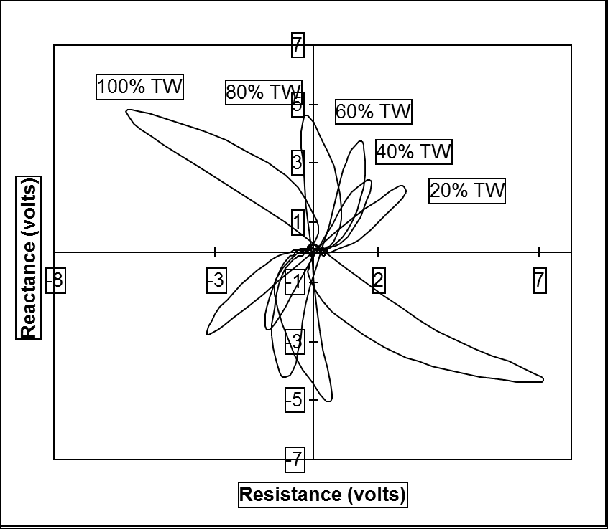
Typical Impedance Plane plots for a tube with different size holes
ASME Standard Tube Specimen (TW: Tube Wall)

Slide 33
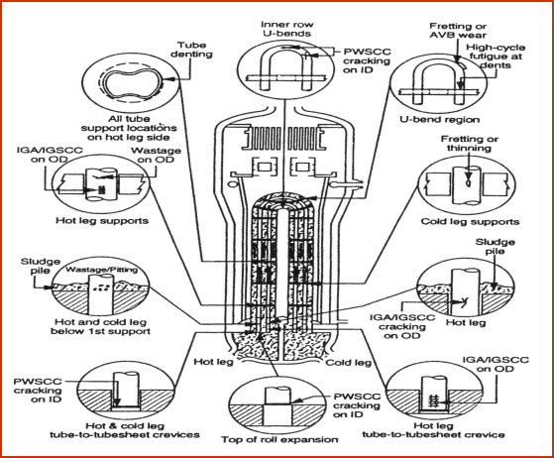
Structural Defects in a U-Tube Steam Generator

Slide 34
Advantages of ECT
Examination is rapid and easily automated.
A permanent record of examination results can be obtained.
Examination of coated materials and coating thickness measurements are possible.
Adaptable to a wide range of materials and configurations.
Entire volumes of thin materials such as tubing can be examined.

Slide 35
Disadvantages of ECT
ECT can be applied only on electrically conductive materials.
Sensitive only to surface and near surface discontinuities.
Since various factors (such as geometry, probe wobble, electrical and magnetic properties) may affect eddy current signals, data interpretation requires highly trained personnel.

Slide 36
Ultrasonic Examination
Ultrasonic examination is a volumetric technique that uses sound waves (ultrasonic waves) with frequencies greater than the human hearing limit (20 kHz).
Sound waves are used because they propagate very well in metals and poorly in air.
Ultrasonic test frequency range: 0.1 – 25 MHz
Piezoelectric transducers are used to convert an electrical signal to high frequency sound waves.
The waves propagate into the medium and reflected from the far surface. The reflected waves are detected by the same or by a different transducer.

Slide 37
Principle of Ultrasonic Examination
The typical power and process industry applications use the pulse-echo ultrasonic technique.
A transducer receives a high-frequency pulse that causes it to vibrate, generating ultrasonic waves in the piezoelectric material.
The acoustic pulse travels through the specimen until it is reflected from either the back surface (Backwall) or some other discontinuity.

Slide 38
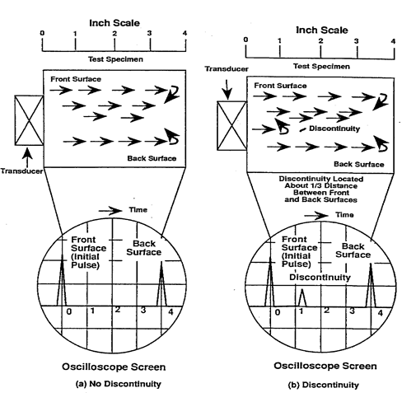
Typical Ultrasonic Normal Beam Pulse-Echo Test with Oscilloscope Display

Slide 39
Principle of Ultrasonic Examination
The reflected waves are detected by the same transducer and the information is processed to determine the location of the flaw.
The large signal on the left represents the initial high voltage pulse applied to the transducer.
The signals to the right of this initial pulse represent reflections from internal discontinuities and the back surface.
The position along the horizontal scale is calibrated to represent actual component thickness.
Decrease in signal amplitude is the indicator of flaw dimension

Slide 40
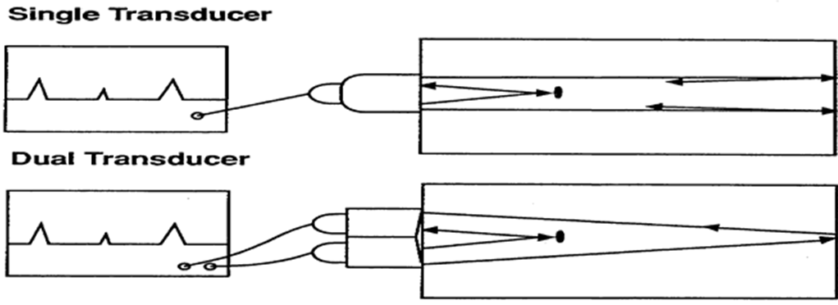
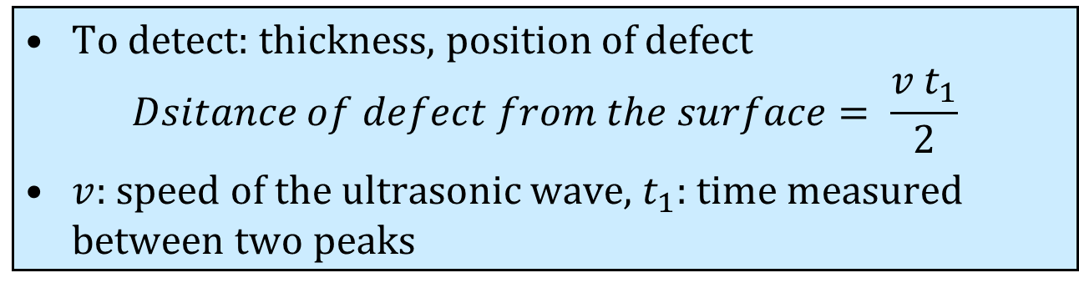
Example of Single and Dual Transducers
To detect: thickness, position of defect
$$Dsitance of defect from the surface= \frac{v t_{1}}{2}$$
$v:$speed of the ultrasonic wave, $t_{1}$: time measured between two peaks

Slide 41
Applications of Ultrasonic Testing
Thickness measurement.
Flaw detection and sizing.
Erosion and corrosion damage assessment.
Examination of piping, welding, bolting, turbine rotors, and plant structural components.
Passive ultrasonic testing is used for leak detection.

Slide 42
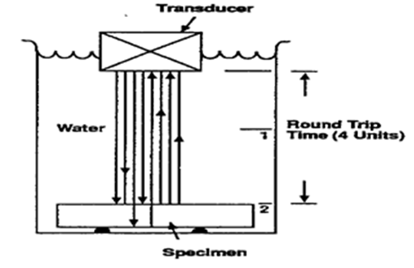
Acoustic Impedance
When the medium changes (at an interface), for example from water to steel, an ultrasonic wave can undergo
Reflection
Refraction
Mode conversion
This is because each medium has different acoustic impedance.
Example of Transmission and Reflection

Slide 43
Acoustic Impedance
Acoustic impedance is defined as Z = ρV
ρ = density of the medium
V = velocity of sound wave in the medium
Z_{steel} = 4.4556 g/cm²·μ sec
ρ_{steel} = 7.9 g/cm³, V_{L} = 0.564 cm/μ sec
Z_{water} = 0.149 g/cm²·μ sec
ρ_{water} = 1.0 g/cm³, V_{L} = 0.149 cm/μ sec
Z_{air} = 0.00004 g/cm² · μ sec
ρ_{air} = 0.000129 g/cm³, V_{L} = 0.0331 cm/μ sec

Slide 44
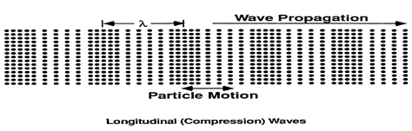
Wave Propagation
Medium of propagation could be solids, liquids, and gases.
In longitudinal wave propagation in a material, the molecules vibrate back and forth parallel to the direction of wave.
In general, other types of wave propagation such as shear waves must be considered.

Slide 45
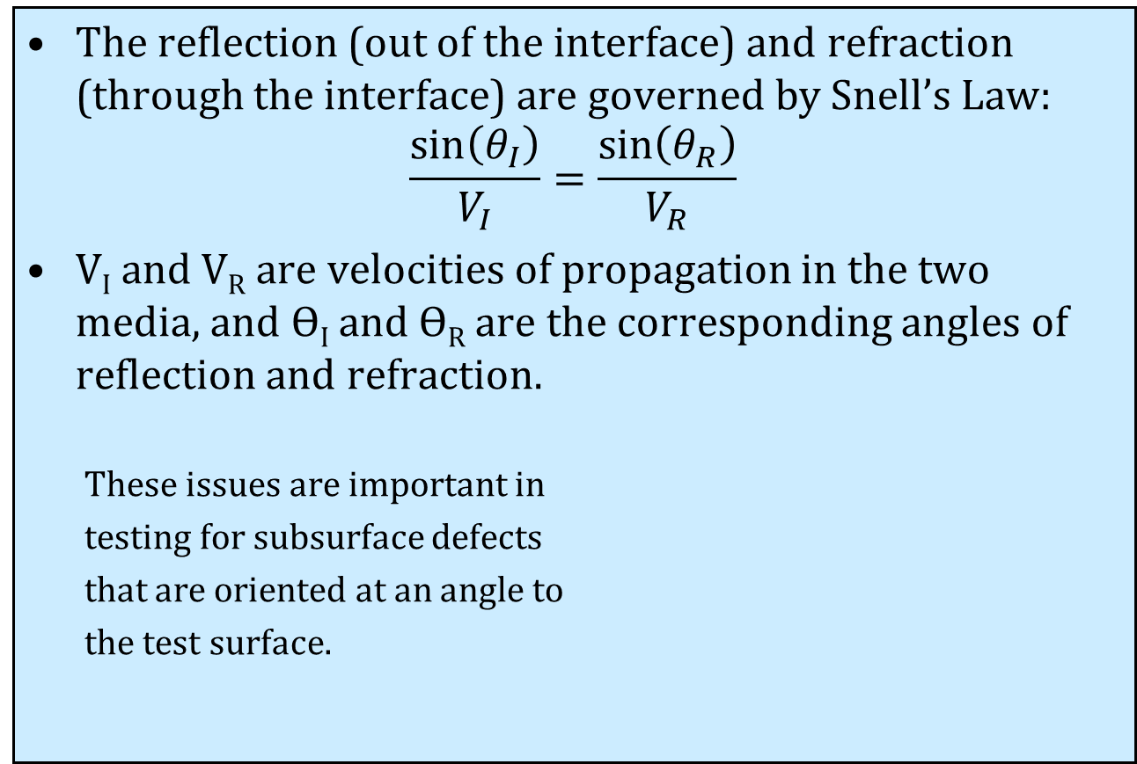
Wave Propagation
The reflection (out of the interface) and refraction (through the interface) are governed by Snell’s Law:
$$\frac{\sin\left(θ_{I}\right)}{V_{I}}=\frac{\sin\left(θ_{R}\right)}{V_{R}}$$
V_{I} and V_{R} are velocities of propagation in the two media, and ϴ_{I} and ϴ_{R} are the corresponding angles of reflection and refraction.
These issues are important in
testing for subsurface defects
that are oriented at an angle to
the test surface.

Slide 46
Coupling to the Surface
As the wave travels from a low density to a high density surface (from low acoustic impedance to high acoustic impedance) there is more reflection off the high density surface than transmission through it.
When the wave travels from a high density to a low density medium, at the interface of the two media, there is more reflection into the higher density medium than transmission into the low-density medium.

Slide 47
Coupling to the Surface
In practical applications high frequency vibrations do not travel through air with enough range and intensity to introduce enough energy into the test material.
A couplant is used to make good acoustic contact between the transducer and the component, enabling sound to be transmitted.
Commonly used couplants: glycerin, water, etc.
The couplant acts to exclude air and to some extent acts as a lubricant as the transducer is scanned over the surface.
For examining vessels from inside, an immersion technique is used in which the water acts as a couplant between the transducer and the surface.
Nondestructive Evaluation Sourcebook, EPRI NP-7466-SL, September 1991

Slide 48
Flaw Characterization
Amplitude of the reflected signal is used to classify the flaw-type. Flaw location can be performed accurately by detecting changes in the reflected signal.
Ultrasonic testing can also generate an image of the flaw area and is useful in the volumetric evaluation of the defect.

Slide 49
Advantages and Disadvantages of Ultrasonic Testing
Provides effective and sensitive volumetric examination.
Entire volume can be examined in many situations with access only from one major surface.
Sensitivity can be adjusted to detect small flaws.
Ultrasonic testing can be highly automated.
Interpretation of signals requires considerable experience.
Examination of large components could be tedious and time consuming.
Rough surfaces are difficult to examine.
Automated equipment is expensive.

Slide 50
Additional References
X.E. Gros, NDT Data Fusion, John Wiley & Sons, Inc., London, 1997
D. Ensminger, L. J. Bond, Ultrasonics: Fundamentals, Technologies, and Applications, CRC Press, Boca Raton, FL, 3rd Edition, 2012
C. Hellier, Handbook of Nondestructive Evaluation, McGraw-Hill, 2nd Edition, 2012
Links:
www.asnt.org
www.youtube.com/watch?v=6oRQTJ1BuKI

Slide 51
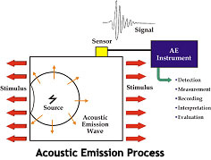
Acoustic Emission (AE) Introduction
A powerful passive method for real-time investigation of material behavior under mechanical and/or thermal stress
AE is a natural phenomenon in a material deforming under stress, in which localized structural changes (i.e. deformation)within the material result in rapid release of strain energy that leads to emission of transient elastic waves
www.pacndt.com

Slide 52
Acoustic Emission (AE) Introduction
Materials under stress accumulate energy.
Elastic waves: produced by sudden deformation
Stress: tensile, compressive, shear
AE is associated with plastic strains.
AE signal is dependent on wave propagation between the source and the sensor (different paths are possible)
Significant factors in wave propagation:
Wave velocity (material dependent)
Wave modes (compression, shear, etc)
Multiple path and reflections
Attenuation

Slide 53
Acoustic Emission (AE) Merits and limitations
Sensitivity to surface and subsurface micro-damage
Sensitivity to various loads
Localization with multiple-sensors
Acoustical reaction to permanent deformation processes such as twinning, slip and micro-crack formation
Wide frequency range (20–1200kHz)
Corrosion detection
Identification of friction, solidification , and phase transformation.
Not geometry-sensitive
High sampling rate
Sensor placement & attenuation

Slide 54
AE Application
In process weld monitoring
Tool wear monitoring
Detection of wear and loss of lubrication
Detection of loose parts/particles
Monitoring of leak, cavitation, and flow
Monitoring chemical reaction (e.g. corrosion)
R.K. Miller and P. McIntire, Ed., Nondestructive Testing Handbook, American Society for Nondestructive Testing, 1987

Slide 55
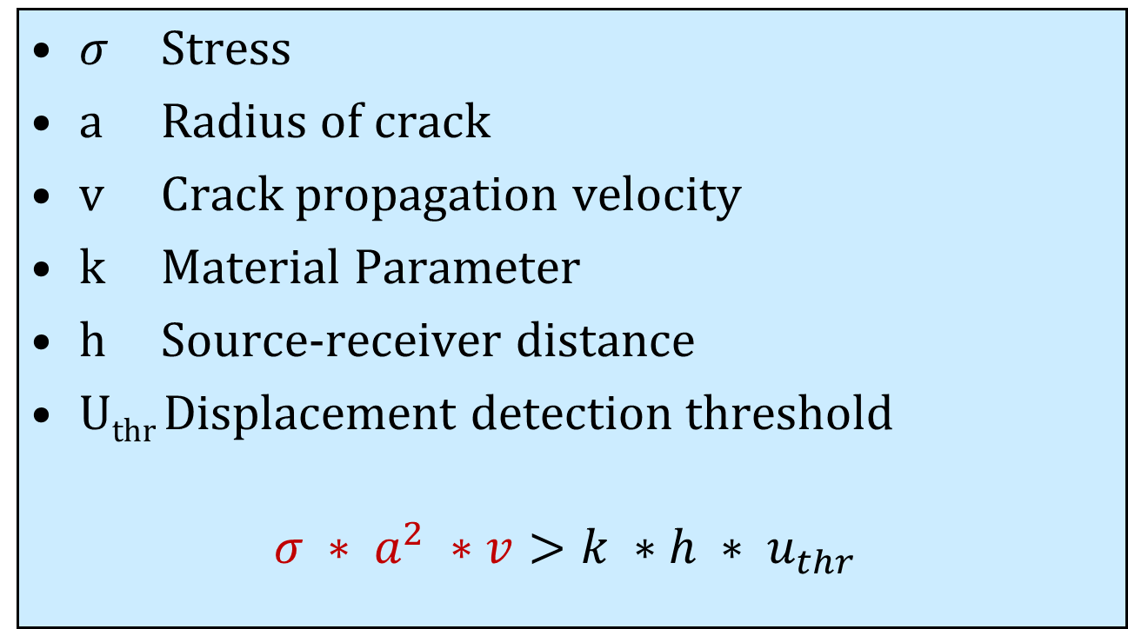
Acoustic Emission (AE) Example in steel crack propagation
$σ$ Stress
a Radius of crack
v Crack propagation velocity
k Material Parameter
h Source-receiver distance
U_{thr} Displacement detection threshold
$$σ ∗ a^{2} ∗v>k ∗h ∗ u_{thr}$$

Slide 56
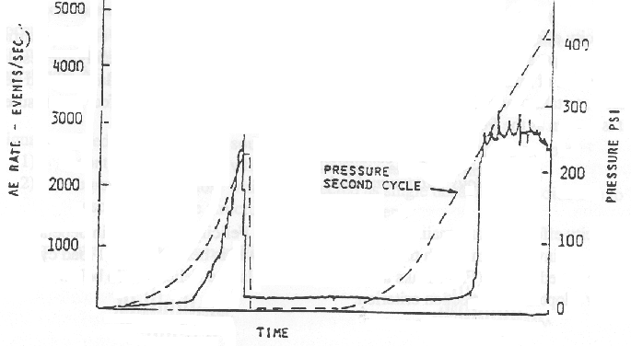
Kaiser effect
Kaiser studied AE signals from various samples: zinc, steel, aluminum, copper and lead.
Source of emission: grain boundary sliding
Crystals that had been stressed before would not give out acoustic emission until the previous maximum stress was exceeded.
The Kaiser effect is an irreversible phenomenon and it is found in both metals and composites.

Slide 57
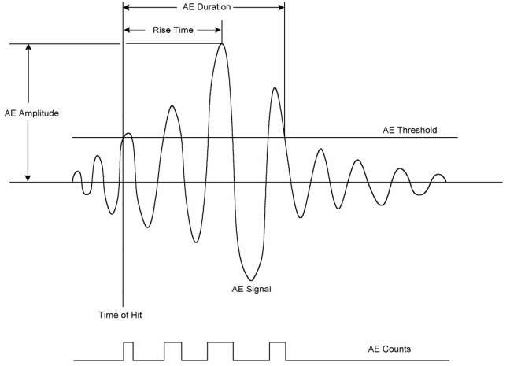
AE Signal
The most common measurable characteristics of the AE signal include
peak amplitude (function of AE source scale and velocity)
Energy
Duration, Counts, rise time
More features
root mean squared (RMS)
AE cumulative event count
Counts to peak
Rise time slope
Crest factor and Kurtosis
Distribution of events versus the above-mentioned parameters c
(Physical Acoustic Corporation, 2007)

Slide 58
AE Signal & Noise
Background noise is an integral part of AE signals
Mechanical:
Operation noise
Fluid flow
Friction
Human activities
Electrical:
White noise generated at the front end of the preamplifier
Electromagnetic interference from neighborhood
Noise generated in acoustic emission systems
Noise elimination: data processing, use of sensors with built-in preamplifiers, sensitivity adjustments such as floating-threshold

Slide 59
Count Data
AE count is defined as the number of threshold crossing of the AE signal
This parameter is also known as ring down count (RDC) or threshold crossing count.
AE counts imply the existence of a transient wave in the AE waveform.
One major drawback of this parameter is the dependence on the threshold level and the amplitude of the AE pulses.
The average counts is a measure of AE intensity i.e. the size of the emission signals detected.
AE counts divided by duration gives the average frequency of the signal.

Slide 60
Count Data
Defects in gear systems would result in broader distribution of AE counts and peak amplitude. AE counts showed better results than other AE parameters in gear defect detection. (Tandon and Mata, 1999)
AE cumulative event count increases with crack growth in the case-hardened gears. (Miyachika, Oda, Koide, 1995)
Direct relationship between AE count and speed in case of outer race defect. (Tandon and Nakra, 1990)
AE count is able to detect large defects up to 15 mm in lengths and 1 mm in width. (Morhain and Mba,2003)
Sensitivity of AE counts to the level and grade of lubricant within the bearing.
It is worthwhile to note that correlating the AE parameters and the feature of interest in the literature is primarily based on linear regression.

Slide 61
AE & Materials
AE is material sensitive (depends on material structure and deformation mode
Ductile material shows low emissivity in comparison with brittle material (Physical Acoustic Corporation, 2007)
AE source in metals: dislocation movement in plastic deformation or the initiation and growth of cracks
AE signal is weak during tensile deformation with the exception of yield and fracture region (Suman, A., et al. 2007)
In glass-fiber-epoxy composites (Bhat, M.R. and C.R.L. Murthy, 1993)
Matrix cracking that produces low-amplitude AE events
Crack propagation and de-bonding generates less AE events with reasonably detectable signal amplitudes
Fiber fracture generates high-amplitude signals

Slide 62
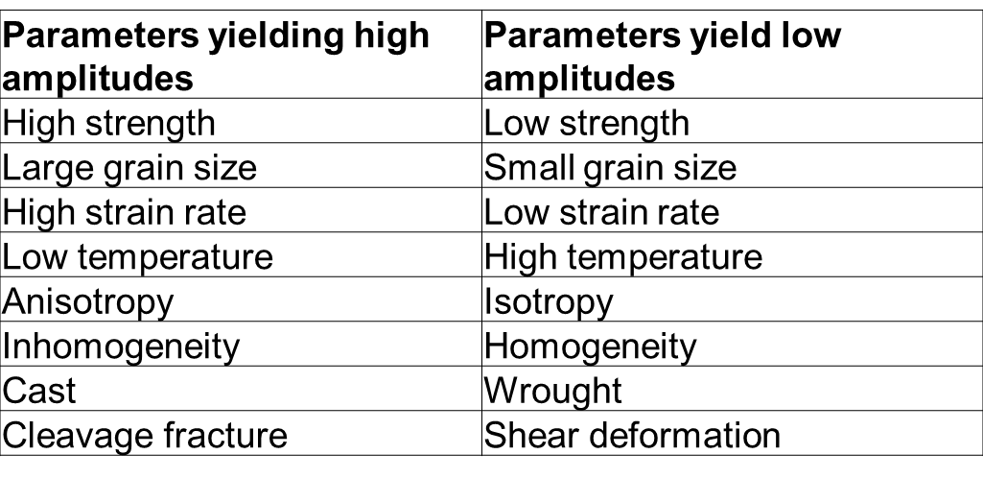
AE Amplitude
Amplitude of the AE signal are affected by a number of parameters:

Slide 63
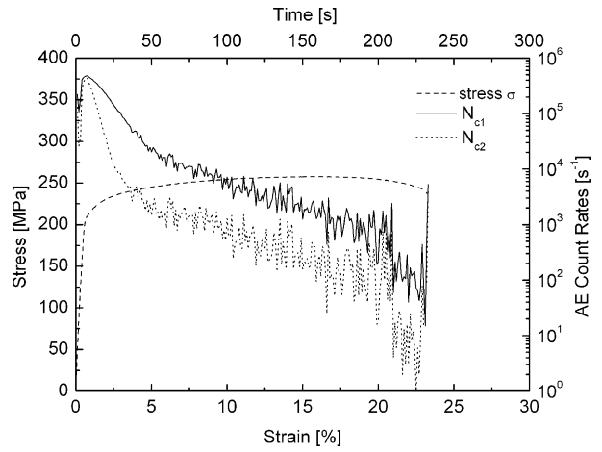
AE Signal: Crystalline materials
Crystalline materials generate high-energy AE in the yield region, which will be diminished after yielding
Stress-strain curve and the relevant AE count rate for AZ31 in tensile test

Slide 64
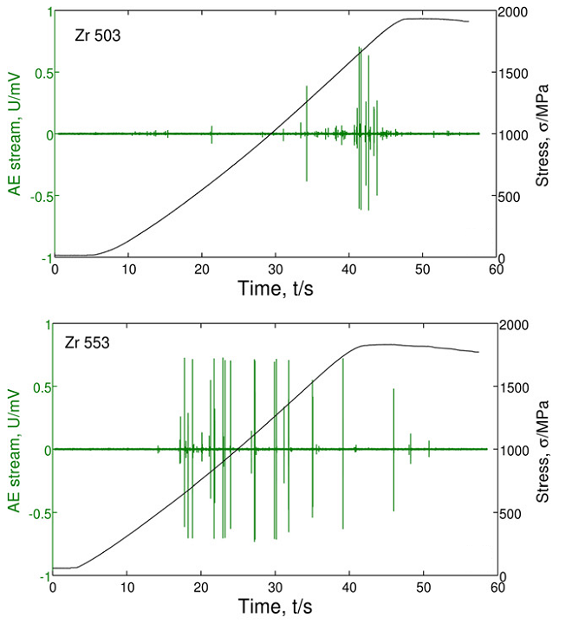
AE Signal in Bulk Metallic Glasses
Non-uniform and non-monotonic AE signal in BMGs
Clear burst type with sharp extremums is expected in BMGs
Maximum activity of AE signal in BMGs does not necessarily represent the failure
Typical AE bursts in BMGs appear within a range of 100-200 micrometer
AE response for Zr₅₀Cu₄₀Al₁₀ during compression tests
(Vinogradov, A. and A. Leksovskii, 1996)

Slide 65
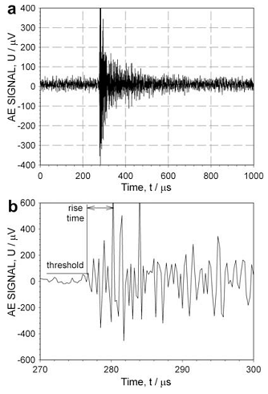
Plastic deformation in BMGs (Literature Review)
AE transient wave corresponding to the shear band propagation
(Vinogradov, A., et al., 2010)

Slide 66
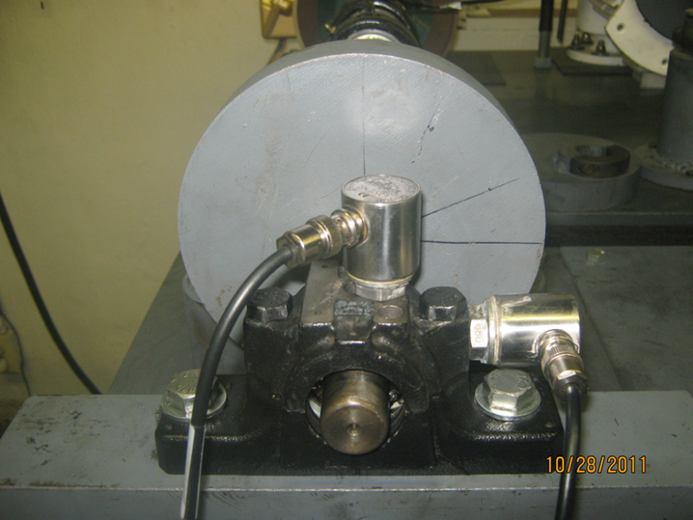
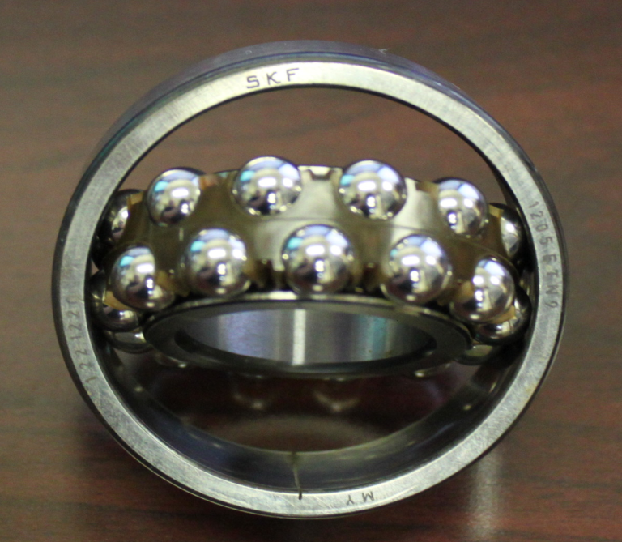
TESTS
SKF 1205 ETN9
Self-aligning ball bearing
Cylindrical bore, unsealed
Inner diameter: d = 25 mm
Outer diameter: D = 52 mm
Thickness: B = 15 mm

Slide 67
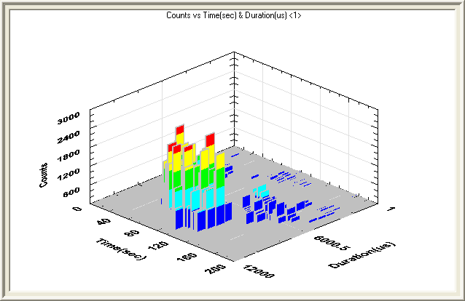
AE for different shaft speed

Slide 68
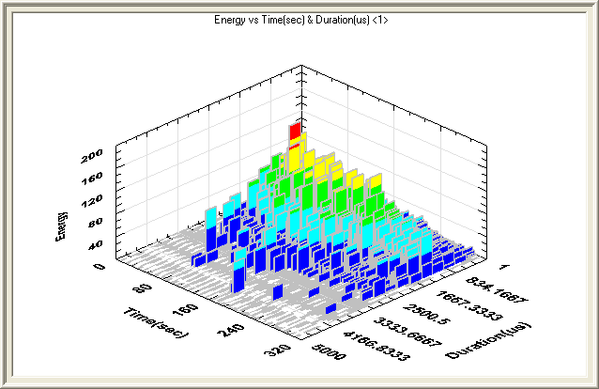
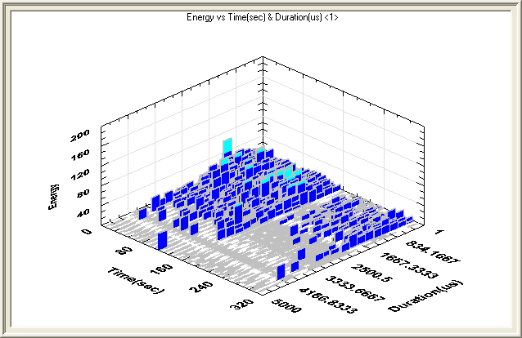
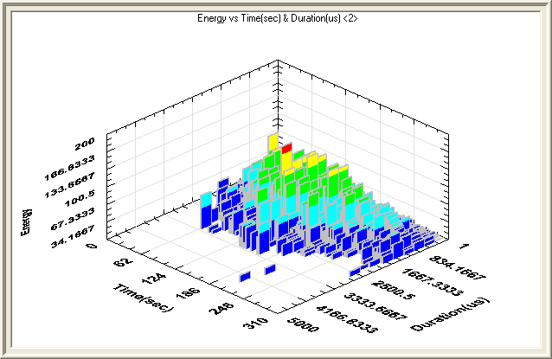
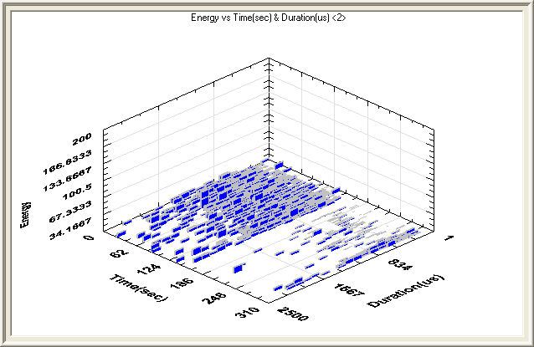
Sensor Placement Energy vs. time (Sec) vs. duration (Micro-sec)

Slide 69
Nondestructive Examination Thermography

Slide 70
Introduction
Objective: understanding and monitoring the thermal response of a system during normal operation and abnormal situations.
Material properties
Deformations
Over-loading
Friction
Chemical reactions
Insulation problems

Slide 71
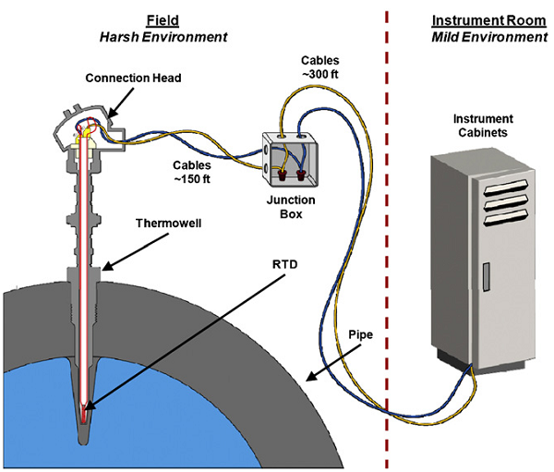
Temperature sensors Contact methods
Resistance Temperature Detector (RTD)
Resistance thermometers
A precision resistor made by a wire coil or a thin layer of metal.
Temperature is determined by the change in the resistance value
High Accuracy and repeatability
Range: -260-850 C
Expensive and fragile
Platinum as the resistive material
Hashemian, H.M., Aging management of instrumentation & control sensors in nuclear power plants, Nuclear Engineering and Design 240 (2010) 3781–3790

Slide 72
Temperature sensors
Thermocouples
Two wires of dissimilar metals that join at both ends.
A continuous current flows when
The signal (voltage) is proportional to the temperature difference.
Range: -200-1800 C
Thermistor
Thermally-sensitive resistor constructed with metal oxides
Change in resistance is several times greater than an RTD
Range: -80-300 C
Cheap and fragile

Slide 73
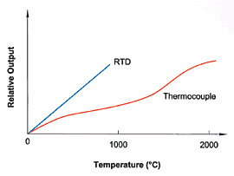
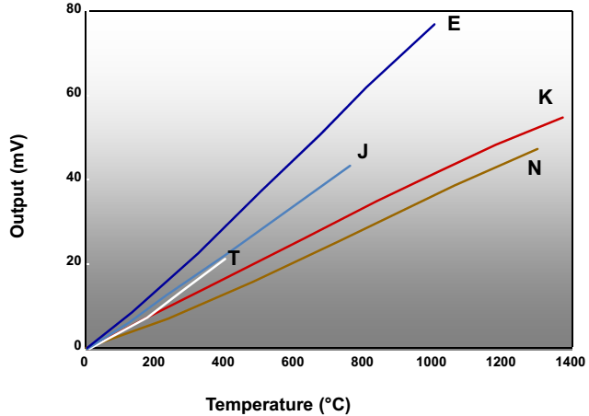
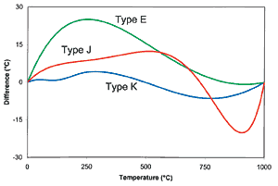
Temperature sensors
Hashemian, H.M., “Comparison of RTDs and Thermocouples for Industrial Temperature Measurements.” Presented at the 8th Temperature Symposium, ISA—The Instrumentation, Systems, and Automation Society, Chicago, IL (October 21-24, 2002)

Slide 74
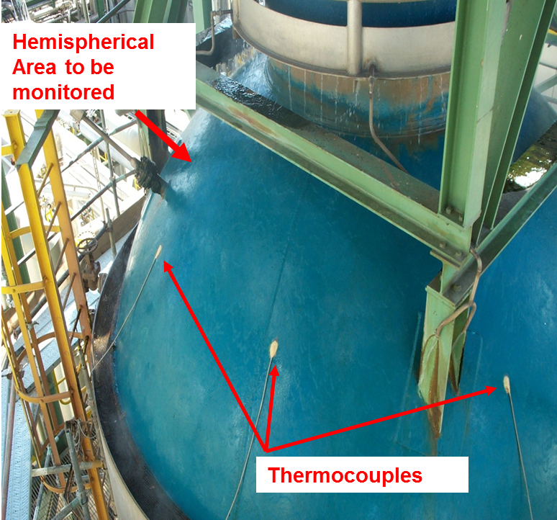
Critical Vessel Monitoring
The top section of this high temperature / high pressure vessel is being monitored by 8 single-point thermocouples.
Areas outside the measurement points could potentially fail without warning and cause catastrophic damage.

Slide 75
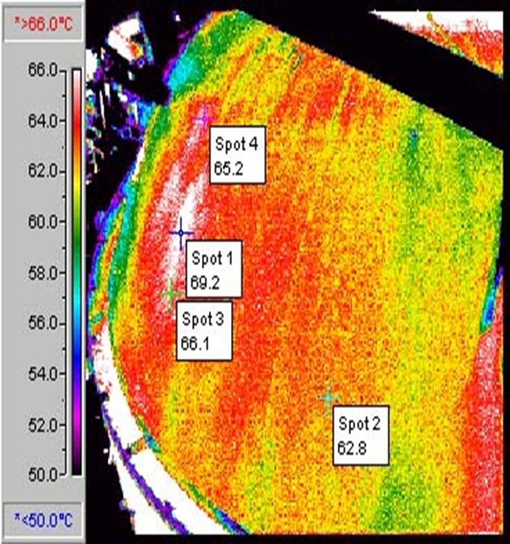
Critical Vessel Monitoring
The Solution:
IR cameras can thermally detect problem areas over an entire area, as opposed to a single spot.
These images can then be sent to the control room for “alarms” and 24/7 monitoring.

Slide 76
Covering the Spectrum
Electromagnetic Spectrum…
Microwaves
Visible
Infrared
Ultra-
Violet
Radio
X-Rays
UHF VHF
Visible
Infrared
MW
LW
2
5
8
12
micrometers
C = λ·f
Near IR

Slide 77
Infrared Radiation (IR)
All objects above absolute zero emit energy or radiation.
IR is one form of this emitted energy
IR has the shortest wavelength.
IR radiation increases with temperature. IR radiation is minimal at Low temperatures
IR is generated by the vibration of electrically charged particles
IR travels through space at the speed of light
The difference between light and IR is wavelength

Slide 78
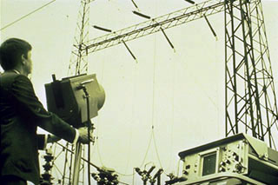
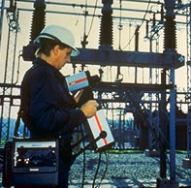
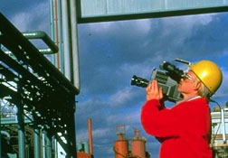
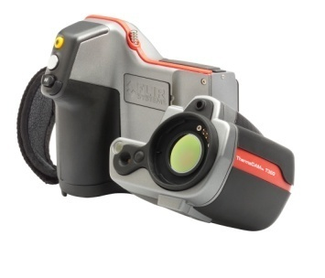
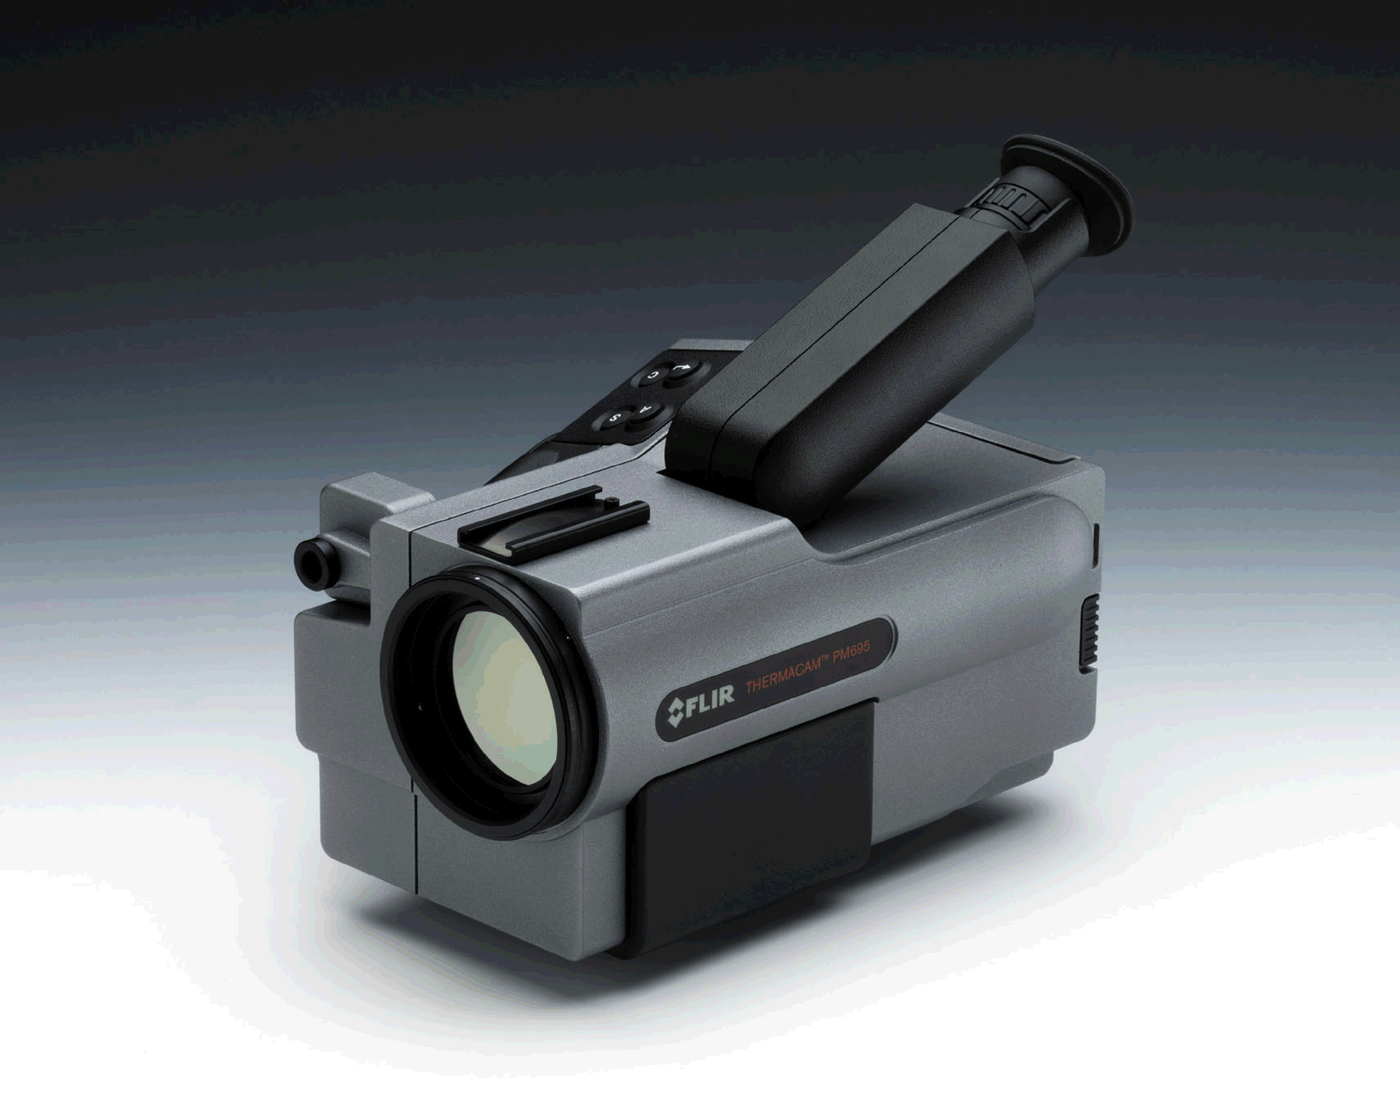
Pioneers In IR Technology
1965
1973
1985
2007
2000

Slide 79
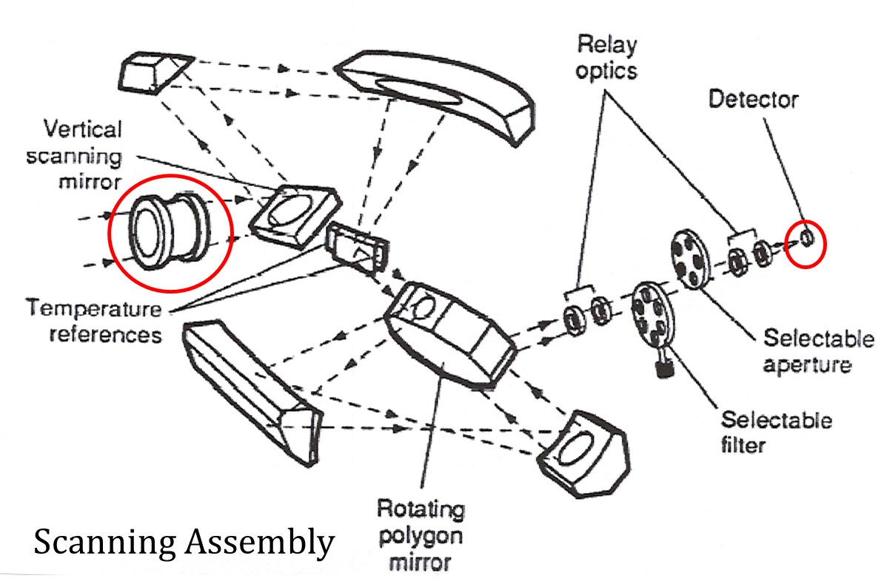
Evolution of IR Technology

Slide 80
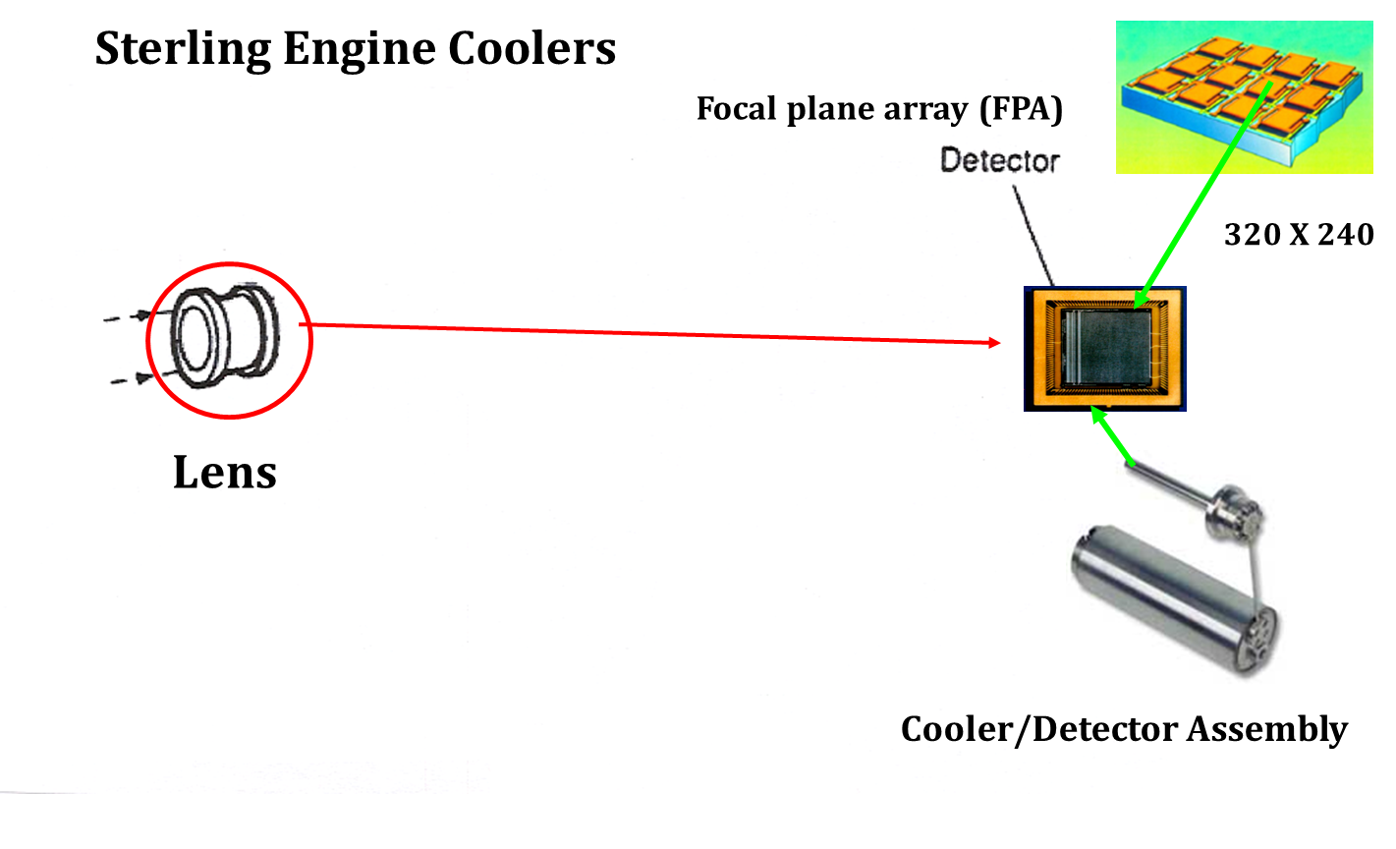
Evolution of IR Technology
No Liquid Coolants

Slide 81

Evolution of IR Technology

Slide 82


Evolution of IR Technology

Slide 83

How IR Cameras Work
In a Focal Plane Array Camera the Image Is Produced by Radiation (Photons) Striking the Array.
Photons Impact and HEAT the Detector Element. The RESISTANCE of the Detector Changes. The Change is Measured and Converted into an Image

Slide 84

How IR Cameras Work

Slide 85
Thermal Radiation
Total radiation = absorbed incident energy + reflection + transmission
1 =  +  + 
Perfect blackbody: total radiation = absorbed incident energy
Emissivity (Kirchhoff’s law): λ = λ
λ : wavelength
1 =  +  + , and if =0, then reflection = 1- emissivity.
Link the radiative properties of objects to a perfect blackbody

Slide 86

Thermal Radiation
$$\text{Emissivity}\text{ = }\frac{Emitted energy from an object}{Emitted energy from a blackbody}$$
Emissivity is a number between 0 and 1.
Emissivity is a function of wavelength.
Greybody: an object with the same emissivity for all wavelengths
Atmosphere attenuates the radiation. This attenuation is a function of wavelength and distance.
Consider: temperature of the ambient surroundings

Slide 87






Application Examples
Electrical Mechanical Refractory

Slide 88


Applications for IR Thermography Electrical Distribution Systems
Overhead Transmission Lines: Loose connections, poor contact, or phase imbalance can result in hot spots
Substations: Loose connections, poor contact, or phase imbalance can result in hot spots

Slide 89





Applications for IR Thermography Electrical Distribution Systems
Breaker Panels: Corrosion, poor connection, or improper load
Hot Bus Connection: Loose or corroded connection

Slide 90

Applications for IR Thermography Electrical Distribution Systems
Fuses: Improper load balance, poor connection at “stabs”, or bad fuses can cause overheating

Slide 91


Applications for IR Thermography Electrical Distribution Systems - Transformers
Overloading or Connection Problems
Improper cooling, low fluid levels, fouling of cooling system, air lock, poor circulation
Typical Transformer is designed for a 20 year life. Operating one at 110C over design reduces the life to 6 months
Bushings, poor contact, or phase imbalance can result in hot spots

Slide 92


Applications for IR Thermography Mechanical Systems
Bearings/Couplings: Shaft misalignment and lack of lubrication can cause excessive heating
Hot Bearing: May indicate a lubrication or misalignment problem

Slide 93


Applications for IR Thermography Mechanical Systems
Motors: Overheated motors caused by overload, blocked cooling ports, bad windings
A typical motor operating at 10C over design cuts the life of a motor in half.

Slide 94

Applications for IR Thermography Mechanical Systems
Bearings: Overheating indicates bad bearing in roller system.
ROI CASE STUDY…
US Steel Mill
Annual shut down prep. Cost $30,000 to shut down mill for 30 minutes to test roller bearings prior to annual plant turnaround (using vibration analysis).
Using IR reduced the plant shut down time from 30 to 5 minutes. Saved the plant $25,000!!!

Slide 95




Applications for IR Thermography Process Applications
Drive Sprockets
Poor Lubrication

Slide 96


Applications for IR Thermography Steam Systems
Wet Insulation: Blanket is saturated with water due to leak in steam tracing. Temperature is lower in the wet area
Wet Insulation: Insulation saturated with water due to leak.

Slide 97


Applications for IR Thermography Fluid/Steam Systems
Steam Traps: Faulty traps, blow by, or frozen shut
ROI CASE STUDY…
US HOSPITAL
Boiler system steam trap study.
Hospital has 800 steam traps. If 15% of these fail per year and go undetected, it can cost them from $100,000 to $300,000 annually.

Slide 98


Applications for IR Thermography Fluid/Steam Systems
Steam Trap Operating Properly
Steam Trap Operating Improperly

Slide 99


Applications for IR Thermography Fluid/Steam Systems
Tank Fluid/Sludge Levels

Slide 100



Applications for IR Thermography Electronics
PCB Inspection
One Fault
Known Good
Loose connections, poor contact, or shorts can result in hot spots.
Five Faults

Slide 101


Applications for IR Thermography Electronics
Confirming Heat Calculations

Slide 102



Applications for IR Thermography Building Diagnostics
Mold
Moisture = Mold
Scan an entire room in seconds. Moisture meters have to make contact with every inch of surface.

Slide 103

Applications for IR Thermography Building Diagnostics
Heat loss surveys

Slide 104




Applications for IR Thermography Automation (24 Hour continuous monitoring)

Slide 105


Infrared Ports
Allows for visual and thermal inspections without removing covers

Slide 106


Remote Substation Monitoring
Allows 24x7x365 of data analysis
Saves Time
Safer
Faster Trending Models
Allows many users to access data
Autonomous Operation
Track potential problems without having to send personnel out to the location.
See information during the day or night and measure the temperature.
Can be used for security purposes, as well!

Slide 107


Other applications

Slide 108


Warning It is illegal to hunt with IR!!!!

